Slide 1
Testing for Income Disparities
Comparing income by gender, race, and education levels in the U.S.

Slide 2
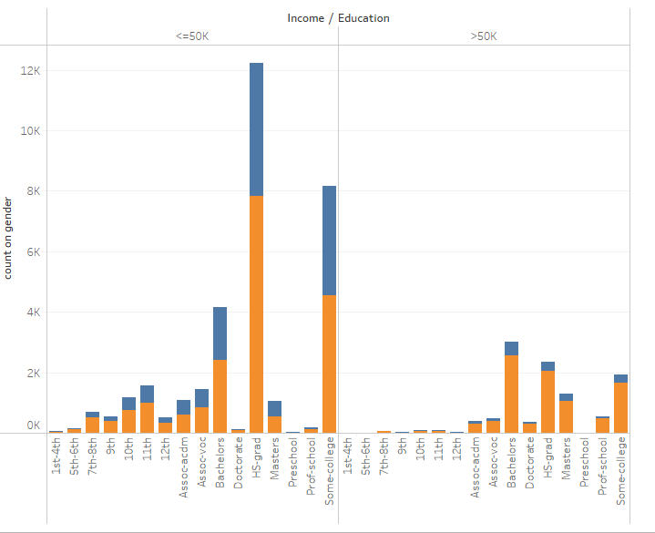
From this sample both men and women generally earn less than $50k especially if they have less than a college degree. Most people with an Associate or Bachelors degree earn less than $50k though the ones than do earn over $50k tend to be men. Males and females than go to professional schools tend to earn higher but more significantly for males. Both males and females with a post graduate degree tend to earn over $50k.

Slide 3
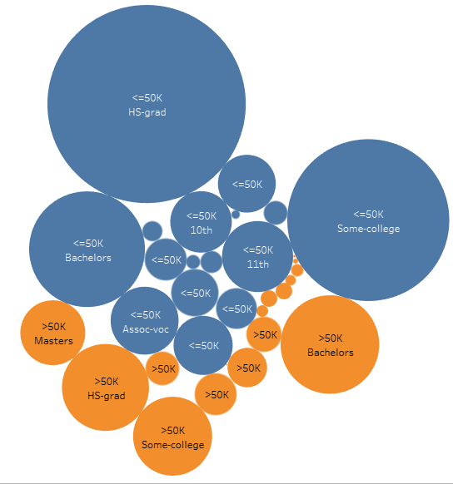
Though there is not exact proof as the majority of people have less than a Bachelors degree it seems than it’s an appropriate point at which the possibility of earning more than $50k changes

Slide 4
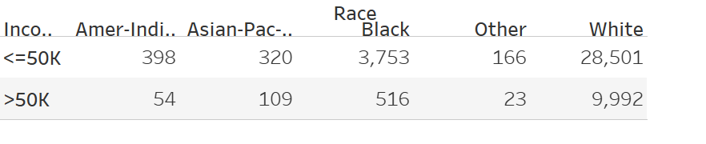
Asian, Pacific Islanders, and White races have about a 3-1 ratio of making below vs above $50k. American-Indian, Black, and others seem to have about a 7-1 ratio of making below $50k.

Slide 5
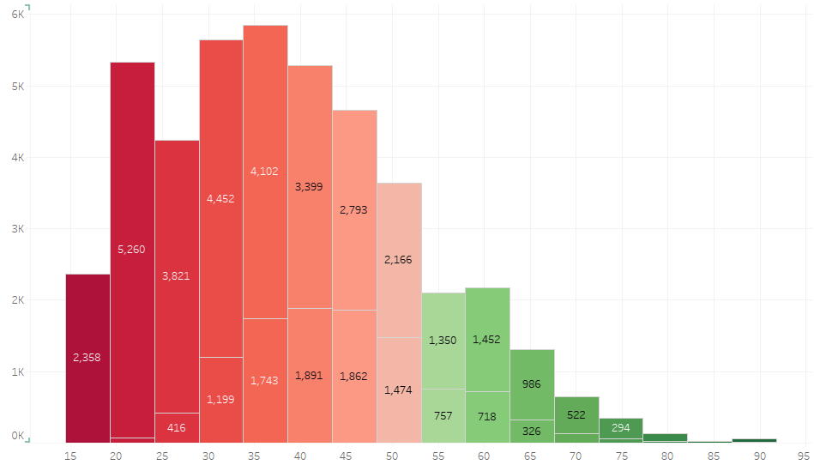
Putting some of the previous factors together along with this final slide might account for earning potential. I might put a hypothesis statement together to see what encompasses the majority of people earning below $50k in their teens – early 20s, a drop in mid to late 20s, then a rise in 30s again, followed by retirement eligibility of social security and end of life. The people who earn over $50k have a more normal distribution with a peak from mid 30s – mid 50s. I suspect this has a combination of education, type of job and gender leading to the correlation. Family circumstances, race, and several other issues could play roles also.

